Slide 1
Note 12 File Indexing
CSC134
Dr. Haiquan Chen

Slide 2
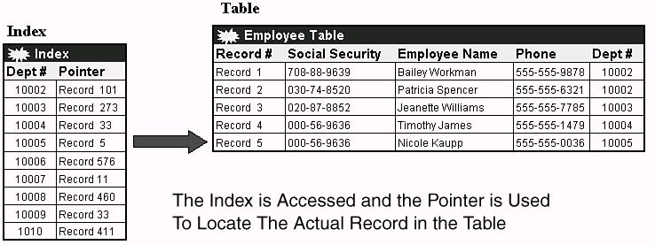
Indexes
An index is a file created for a relation attribute. By using index, the record search for the relation can be more efficient.
An index can be considered as a special table with two columns:
<index value, block address (block pointer) >,
Each row in an index is called as index entry
All the index entries are sorted by index value

Slide 3
Indexes
An index can be either a dense index or a sparse index
A dense index has an index entry for every record in the relation.
A sparse index has index entries for only some of the records in the relation.

Slide 4
Why index can speed up record search?
Searching for an index entry is much faster than searching for a record in the data file. Two reasons:
The index file is much smaller than the data file in size. So it occupies much fewer disk blocks than the data file.
Index file is always an ordered file. So we can use binary search to find an entry in index.

Slide 5
Given the data file EMPLOYEE(SSN, FNAME, LNAME, ADDRESS, ... )
Suppose that:
record size R=150 bytes; block size B=512 bytes, r=30000 records
Then, we get:
blocking factor Bfr = B / R= 512 / 150= 3 records/block
number of file blocks = (r/Bfr)= (30000/3)= 10000 blocks
Without index,
If the file records are unordered, a linear search cost of:
(b/2)= 10000/2= 5000 block accesses
If the file records are ordered on SSN, the binary search on SSN cost would be:
log₂b= log₂10000= 14 block accesses

Slide 6
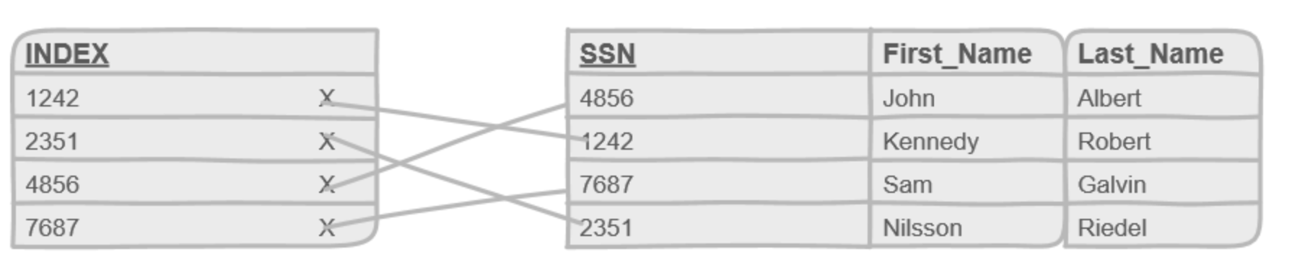
For an index on the SSN field, assume the index field size V_{SSN}=9 bytes and the block pointer size P_{b} =7 bytes. Then:
index entry size R_{I}=(V_{SSN}+ P_{b})=(9+7)=16 bytes
index blocking factor Bfr_{I}= B / R_{I}= 512 / 16= 32 entries/block
If dense index is used:
number of index blocks b= (r/ Bfr_{I})= (30000/32)= 938 blocks
binary search in index needs log₂b= log₂938= 10 block accesses
Need one more access to the data file, total = 10 +1 = 11 block accesses

Slide 7
Types of Indexes
 | Index field is a key | Index field is a non-key
Index field is the physical ordering field of the file | Primary index | Clustering index
Index field is NOT the physical ordering field of the file | Secondary index (on key) | Secondary index (on non-key)

Slide 8
Types of Indexes
Primary Index
Index field is the physical ordering field
Index field is a key
Includes one index entry for each block in the data file;
The # of index entries = # of file blocks
Each index value is the value for the first record in the block (anchor record).
Dense or sparse?
A primary index is a sparse index, since it includes an entry for each file block, rather than for every record.

Slide 9
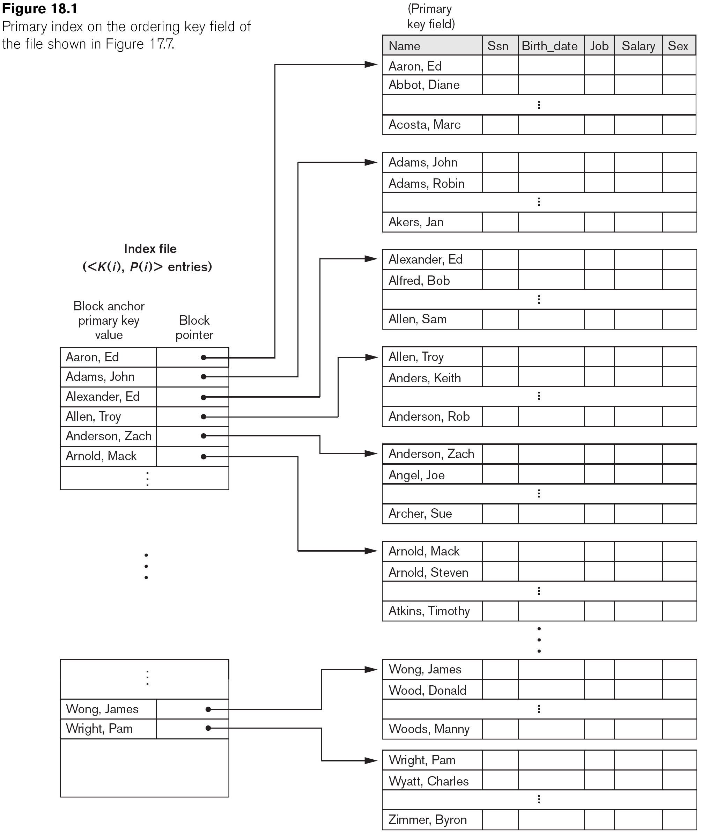
Primary Index on the Ordering Key Field

Slide 10
Search with primary Index v.s. without index
We have an ordered file with r = 30000 records on a disk with block size B = 1024 bytes. Each record length R = 100 bytes.
Blocking factor bfr = 1024/100 = 10 records per block
The number of file blocks = 30000/10 = 3000 blocks
Without index, suppose file is ordered, a binary search needs log23000 = 12 blocks
With primary index, suppose the primary key is 9 bytes and block pointer is 6 bytes
Size of each index entry = 9+6 = 15 bytes
Blocking factor of index file = 1024/15 = 68 entries per block
Because the index is a primary Index
The number of index entries = 3000
The number of blocks for index file = 3000/68 = 45 blocks
To perform a binary search on the index file needs log₂ 45 = 6
Search cost for a record = 6 +1 = 7 block accesses

Slide 11
Types of Indexes
Clustering Index
Index field is the physical ordering field
Index field is a non-key
Includes one index entry for each distinct value;
# of index entries = # of distinct values
The index entry points to the first data block that contains the index value.
Dense or Sparse?
It is a sparse index because it has an entry for every distinct value, rather than every data record.

Slide 12
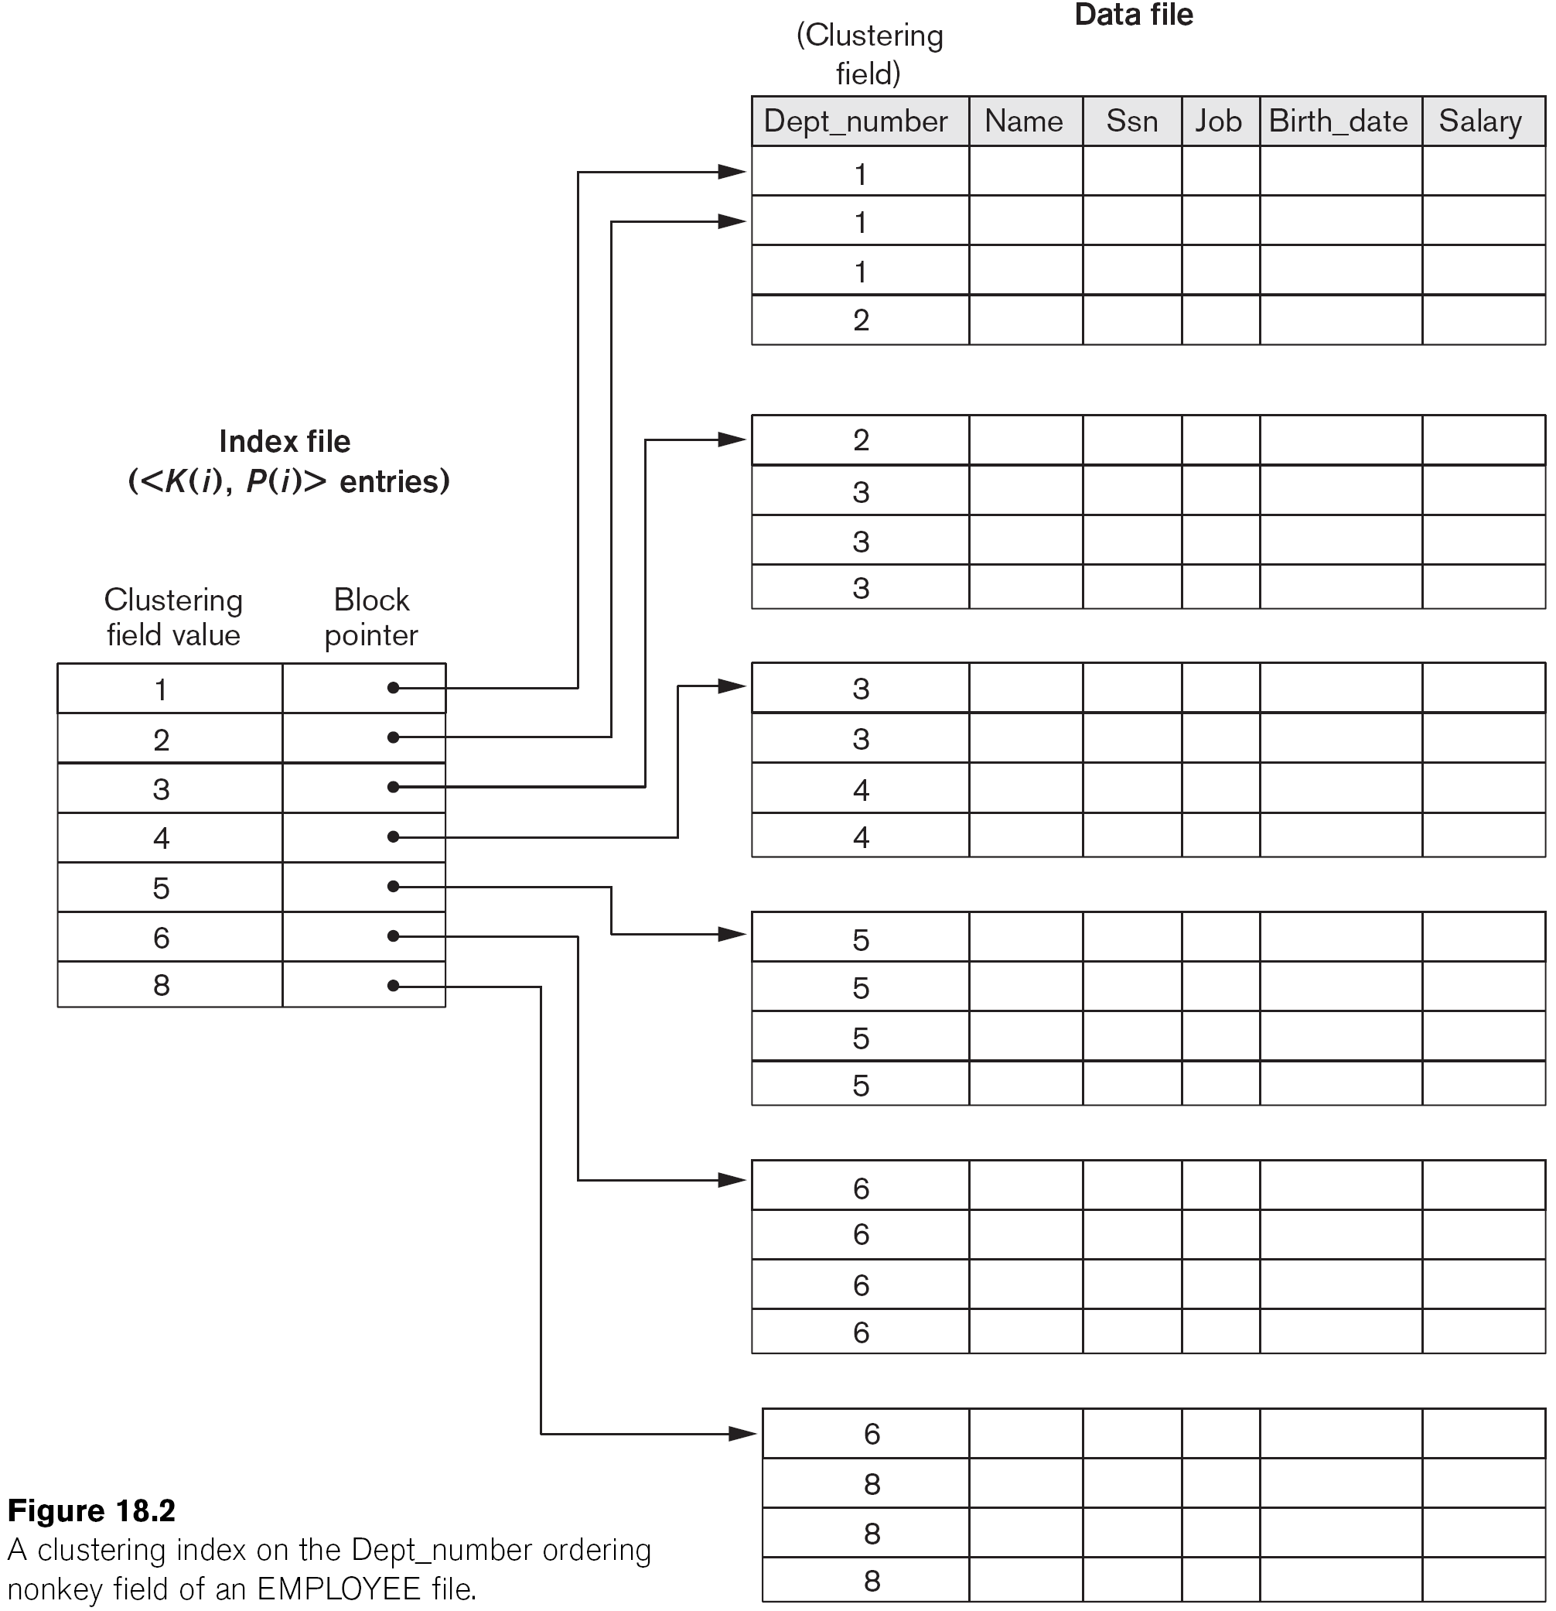
A Clustering Index Example

Slide 13
Types of Indexes
Secondary Index
The secondary index is created on a non-physical ordering field.
Two types of the secondary index
Secondary index on key
Secondary index on non key

Slide 14
Secondary Index on key
Secondary index on key includes one index entry for each data record; hence, it is a dense index

Slide 15
Secondary Index on Key

Slide 16
Secondary Index on non-key
Secondary index on non-key includes one index entry for each distinct value; hence, it is a sparse index
Secondary index on non-key uses additional disk blocks

Slide 17
Secondary Index on non-key, which uses additional disk blocks

Slide 18
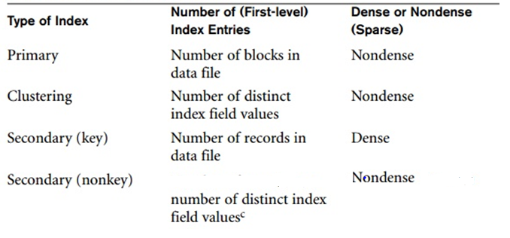
Recap: Properties of index types

Slide 19
Reflection
Given a relation, how many secondary indexes we can create and why?
Given a relation, how many primary indexes we can create and why?
Given a relation, how many clustering indexes we can create and why?
One relation can have many secondary indexes. However, a relation can have only one primary index or one clustering index.

Slide 20
Multi-Level Indexes
When index itself is still big in size, we can create an index to the index.
Because index is an ordered file, if we create an index to the index, the new index will always be a primary index.
We can repeat the process, creating a third, fourth, ..., top level until the top level index can fit in one single disk block.
Such a multi-level index can also be referred to as search tree

Slide 21
A Two-Level Primary Index

Slide 22
Multi-Level Indexes
Search cost with multi-level index = level of index (height of tree) + 1
Such a multi-level index is a search tree
Each node in the search tree is a disk block
However, insertion and deletion with the search tree is a severe problem, why?
Because every level of the index is an ordered file. To make space, many tree nodes need to be modified.
How to fix it?
Leaves space in each tree node for the new incoming entries.
This structure is called dynamic multilevel index (dynamic search tree)

Slide 23
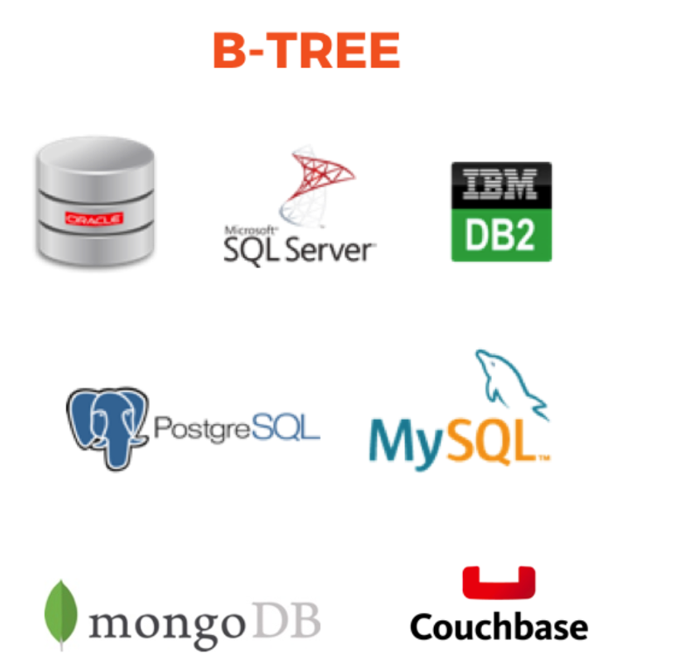
Dynamic search tree (B-Trees and B⁺-Trees)
Like static search tree, in B-Tree and B⁺-Tree, each tree node corresponds to a disk block.
Each tree node in B-tree or B⁺- tree is kept between half-full and completely full to allow efficient insertion and deletion of records.
MySQL uses both BTREE (B-Tree and B⁺-Tree) and HASH indexes.
B⁺-Tree, an extension of B-tree, allows more children in the intermediate nodes than B tree so it is much wider (reduced height).

Slide 24
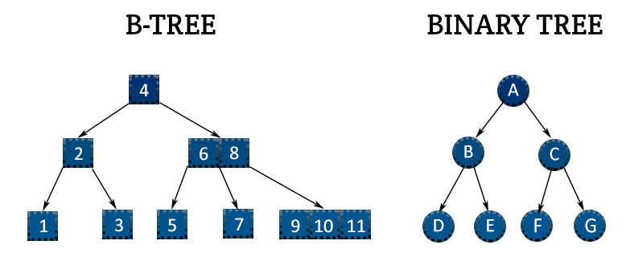
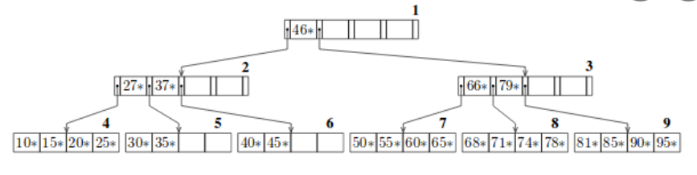
B tree example

